Slide 1
IBM University Engagement Project Submission
“Exploring the Power of Agentic AI with IBM Granite”

Slide 2

Project Tile – Fitness Buddy
Domain of Project – Healthcare
Student Name | Recent Passport Photo | Email ID | Mobile number [WhatsApp]
Debojit Dutta |  | duttadebojit2006@gmail.com | 9091239459

Slide 3
Problem Statement -
The challenge - In today’s fast-paced world, many individuals struggle to maintain a healthy lifestyle due to lack of personalized guidance, time constraints, and inconsistent motivation. Traditional fitness solutions often require expensive subscriptions, in-person consultations, or rigid schedules that don't adapt to personal preferences or daily routines.
There is a growing need for an accessible, friendly, and intelligent virtual assistant that can provide ondemand fitness advice, healthy lifestyle suggestions, and basic nutrition guidance—all tailored to individual needs and available at any time.
Fitness Buddy aims to solve this problem by offering a conversational, AI-powered health and fitness coach that can:
Recommend home workouts and routines based on user input.
• Provide motivational tips and daily fitness inspiration.
• Suggest simple, nutritious meal ideas.
• Encourage habit-building and consistency.
Technology: Use of IBM cloud lite services /IBM Granity is mandatory

Slide 4
Proposed Solution -
Proposed Solution: AI-Powered Fitness Buddy
The proposed solution is an AI-powered Fitness Buddy built using IBM watsonx.ai and Granite Models to provide personalized fitness guidance, workout recommendations, and nutrition assistance. The system addresses common fitness challenges such as lack of motivation, limited time, and difficulty maintaining a healthy lifestyle through an intelligent, conversational AI assistant.
At its core, the solution uses IBM Granite Large Language Models (LLMs) to understand user queries and generate personalized fitness and wellness recommendations based on individual preferences, fitness goals, and daily routines.
The system consists of five key modules:
Personalized Workout Agent recommends home-based workout routines based on users' fitness levels, goals, and available time.
Nutrition Recommendation Agent suggests healthy and affordable meal plans based on dietary preferences, food habits, and fitness objectives.
Fitness Motivation Agent provides daily motivational messages, fitness tips, and encouragement to maintain consistency.
Healthy Lifestyle Agent offers suggestions related to hydration, sleep, physical activity, and healthy daily habits.
Fitness Tracking Agent allows users to track daily workouts, water intake, and fitness progress to monitor their health goals.
The solution includes a user-friendly dashboard built with Streamlit that enables users to interact with the AI assistant, view personalized recommendations, and monitor daily and weekly progress.
IBM watsonx.ai provides the platform for AI model integration and deployment, while Granite models power natural-language understanding, reasoning, and personalized recommendations. Python is used for backend development and application integration.
Overall, this solution delivers an intelligent virtual fitness coach that promotes healthier lifestyles through personalized workout plans, basic nutrition guidance, daily motivation, and consistent habit-building.

Slide 5
Technology Used
IBM BOB platform-For designing and orchestrating the multi agent workflow visually

Slide 6
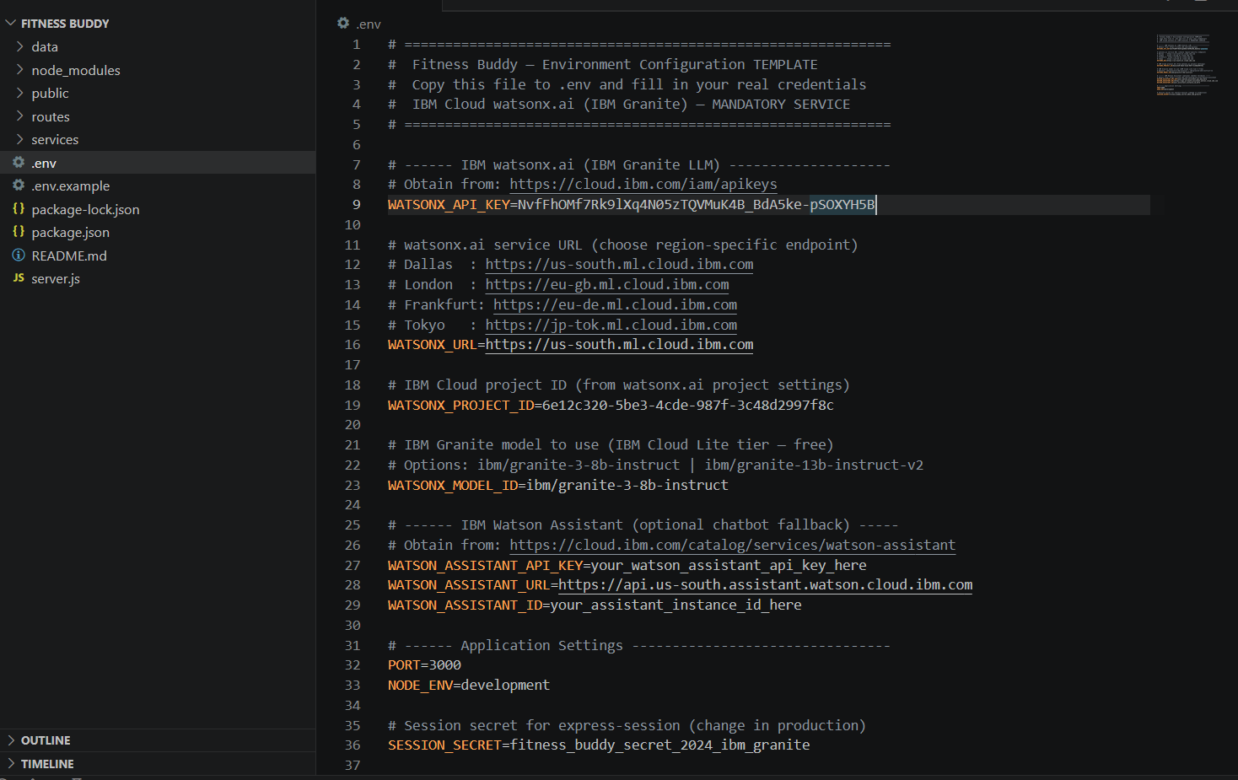
Required files created using IBM BOB-
1. .env
2. .env.example
3.package-lock.json
4.package.json
5.README.md
6.server.js

Slide 7
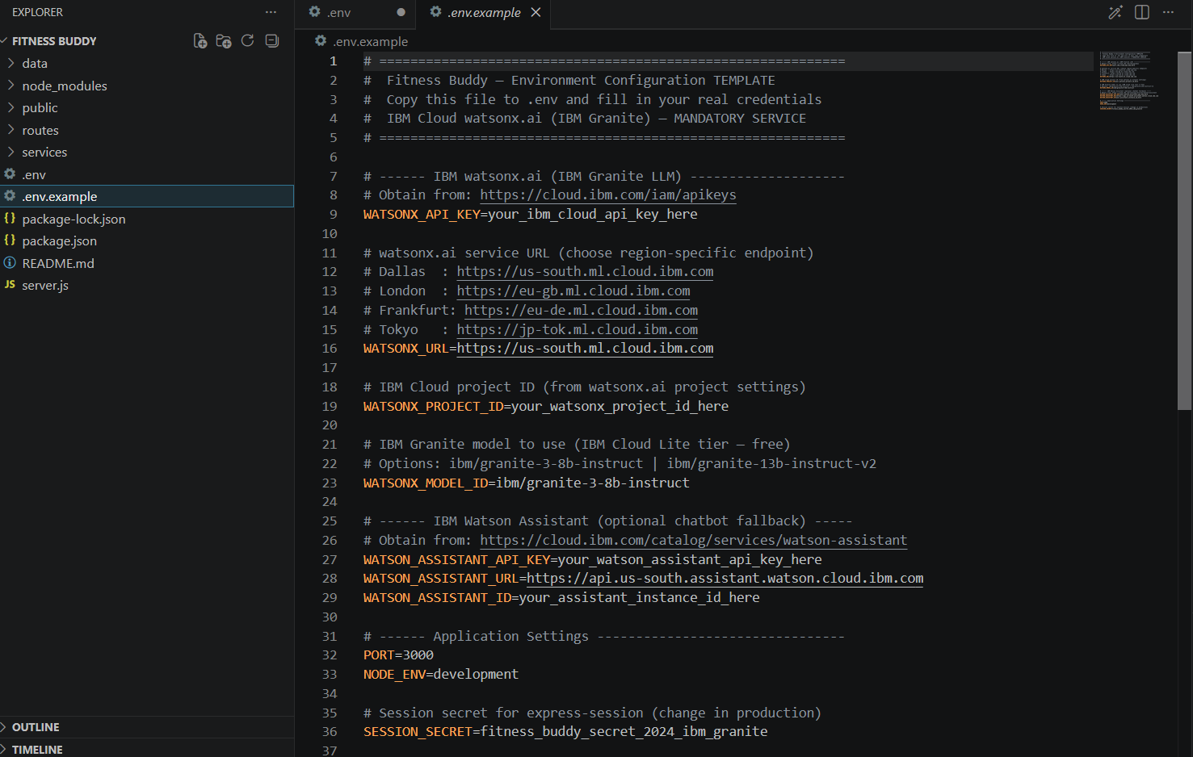
IBM Screenshots-

Slide 8
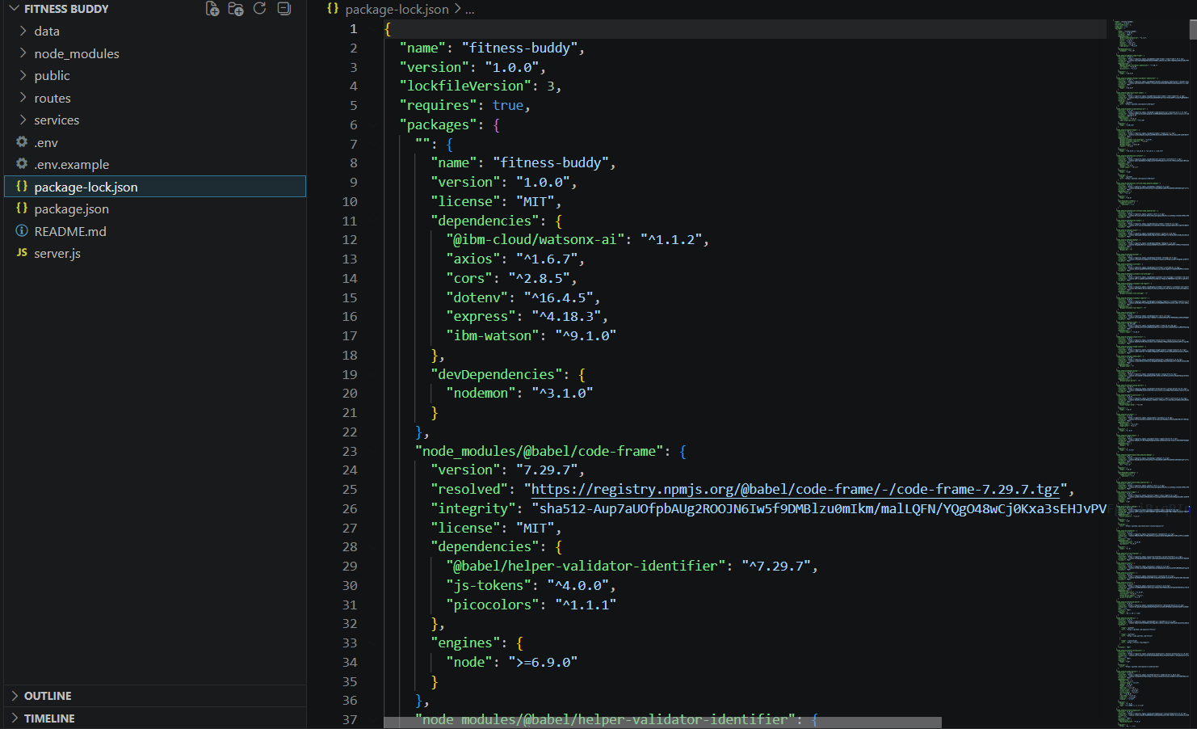
IBM Screenshots-

Slide 9
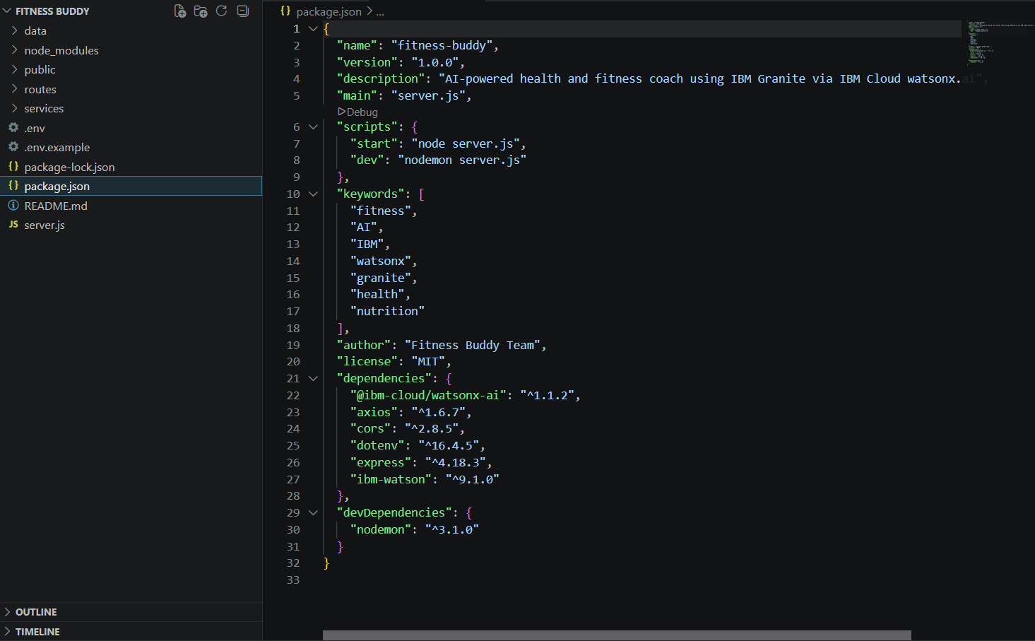
IBM Screenshots-

Slide 10
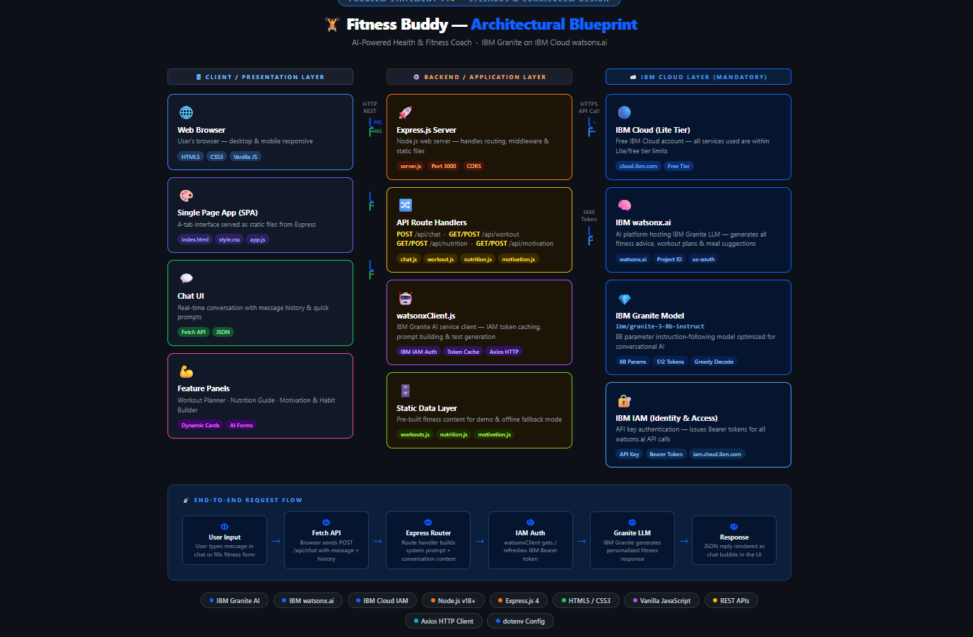
Architectural Blueprint-

Slide 11

Role of Agentic AI in the solution
Role of Agentic AI in Fitness Buddy
Agentic AI enables Fitness Buddy to understand user needs, maintain conversation context, and generate personalized recommendations.
Powered by IBM Granite (ibm/granite-3-8b-instruct) through IBM watsonx.ai, the system acts as an intelligent virtual fitness coach.
Its key capabilities include:
Goal-Based Guidance: Personalized workout and nutrition plans.
Contextual Memory: Remembers previous conversations.
Dynamic Routing: Handles fitness, nutrition, and motivation queries.
Adaptive Responses: Generates recommendations based on user needs.
Responsible AI: Avoids unsafe fitness and medical advice.
Working Process: Perceive → Understand → Plan → Generate → Adapt.
Overall, Agentic AI makes Fitness Buddy an interactive and personalized fitness assistant that adapts to individual goals and preferences.

Slide 12
Novelty and Uniqueness
Novelties and Uniqueness of Fitness Buddy
Fitness Buddy offers a personalized fitness experience through IBM Granite-powered Agentic AI. Its key innovations include:
AI-Powered Coaching: Generates personalized fitness and nutrition recommendations.
Multi-Domain Intelligence: Combines workouts, nutrition, motivation, and habit-building.
Contextual Memory: Maintains conversation history for continuous assistance.
Specialized AI Agents: Provides dedicated workout, meal, motivation, and chat modules.
Smart Motivation: Delivers day-specific fitness tips and encouragement.
Responsible AI: Includes safety guidelines for reliable wellness recommendations.
Lightweight Design: Uses HTML, CSS, and JavaScript for a simple, accessible interface.
Uniqueness: Fitness Buddy combines intelligent personalization, conversational memory, and comprehensive fitness guidance in one accessible AI-powered platform.

Slide 13
Git Hub Link
Github URL – https://github.com/Debojit-Dutta
·
·
·

Slide 14
Future Scope
Future Scope of Fitness Buddy
Fitness Buddy can be enhanced with advanced technologies to provide smarter and more personalized fitness assistance.
Cloud Storage: Store user profiles and fitness history using IBM Cloudant.
Voice Assistance: Enable voice-based interaction using IBM Watson Speech services.
Wearable Integration: Connect smartwatches to monitor physical activities and health data.
Progress Analytics: Provide visual reports of workout performance and fitness goals.
AI Form Detection: Analyze exercise posture using computer vision.
Advanced Nutrition: Generate accurate meal plans using nutritional databases.
Multilingual Support: Support languages such as Hindi, Bengali, and Tamil.
Gamification: Introduce badges, rewards, and workout streaks.
Multi-Agent System: Integrate IBM watsonx Orchestrate for coordinated AI assistance.
Cloud Deployment: Use IBM Cloud Code Engine for scalable application hosting.
Summary: Fitness Buddy aims to evolve into a comprehensive AI-powered wellness platform offering intelligent, personalized, and accessible fitness guidance.
·
·
·

Slide 15
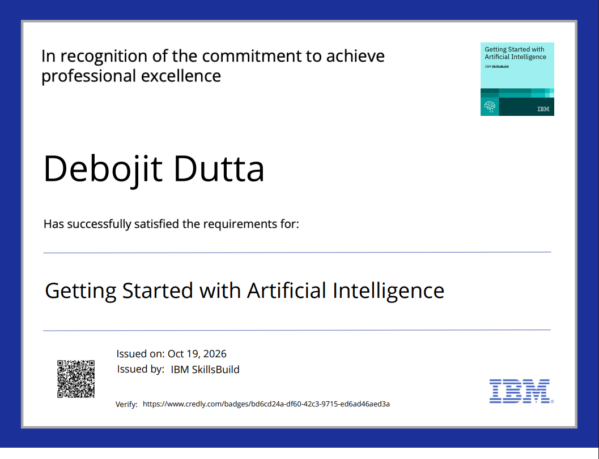
Certificates Earned:

Slide 16
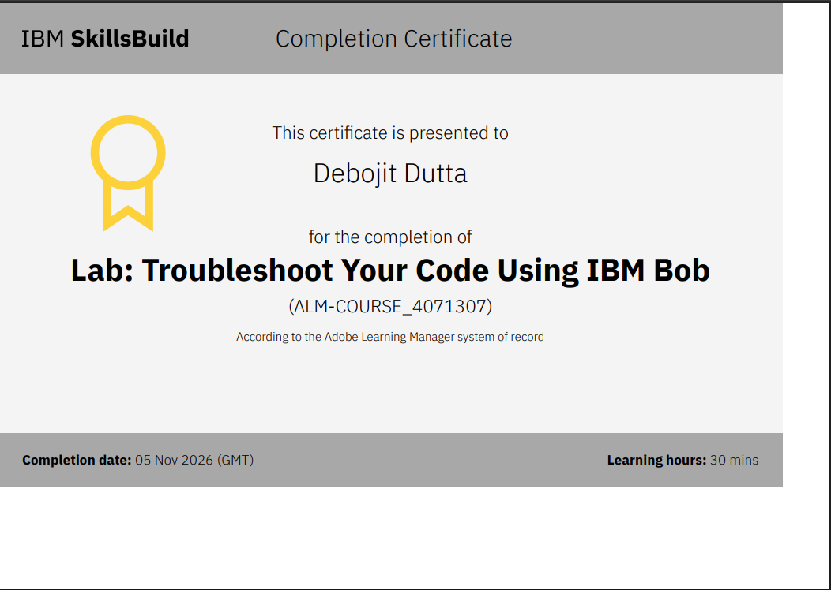
Certificates Earned:​

Slide 17


